Slide 1
Presented By Poungue Brice, Student STATE AGRARIAN UNIVERSITY
Faculty of Economics, specialty management, Course 1
Cameroonian national food
(Republic of Cameroon)

Slide 2
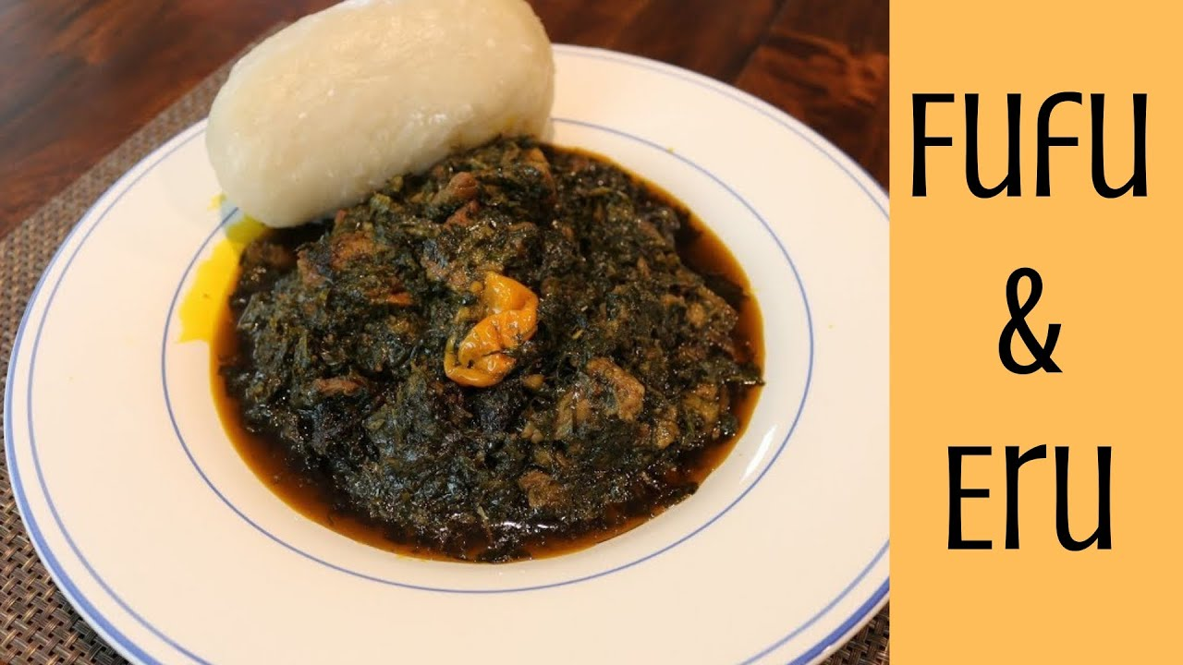
Eru is plant that is harvested from the forest in Cameroon. In Nigeria, it is called “Ukazi” or “Afang”. Natives of cross Rivers state use it to prepare famous “Afang soup”. “Afang soup” has a striking similarity to Eru, but it is more “soupy”, and the ERU is sliced prior to preparation. Another soup that really looks like Eru, is the “Edika Ikong”, also prepared by the calabar people of the Cross Rivers State in Nigeria. It looks almost like Eru.

Slide 3
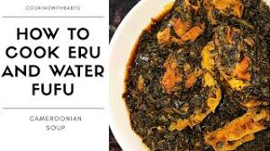
INGREDIENTS:
3 bagsf /bundles of Spinach/Waterleaf
2 or 3 pounds of meat/fish of choice (beef skin/Canda, beef Stripes, stocked fish, snails and/or others)
2 cups of Crayfish
3 cups of Palm oil
crayfish Seasoning cube (Maggi Crevette) as taste disires.
1 pepper (optional)
Salt to taste.
METHOD OF COOKING:
If you are using dried Eru/waterleaf start by soaking it in water
Wash your meat and put in the pot to boil. I used beef skin, and beef stripes.
While the meat boils, chop your spinach or Waterleaf and set aside.
When your meat is half-boiled, season with salt. When it is cooked, add in spinach and start stirring. Spinach is quite soft and will shrink fast.
Then you drain Eru and add to pot. The small liquid from the Spinach will make the Eru soft.
Add in your fish and mix.
Then add the oil, seasoning Cube and lastly Crayfish. Tip: Mixing palm oil keeps the oil from becoming hard when the Eru is cold
Stir well, and directly ,Eru is ready.
You can serve it with water FuFu(Akpu), FuFu corn or Garri or even pounded yam. (Gari is crushed Cassava, dried, and can be mixed with palm oil; so there is two kind of gari: the white gari and the yellow gari)
As here in Belarus, there are no “Gari” l choosed to use “Manaya” to cook water fufu.

Slide 4
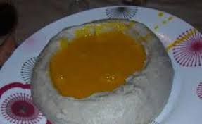
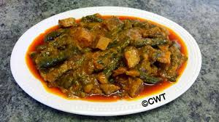
WATER FUFU:
-FUFU
-water
METHOD OF COOKING:
I put 2 or 3 cups of water at the lights, for 1 bag of manaya.
Once the water has boiled, I pour 1/3 of the manaya while stirring with a spatula.
I leave it in the fire for 5 to 10 minutes.
Then, I add the rest of manaya 3 times, while stirring each time,until you get a consistent dough.
Once the fufu/manaya is cooked, l form balls Then l serve it on a dish.

Slide 5
Thanks for attention!

