Slide 1
Presented By ALBAN LYONGA, Student STATE AGRARIAN UNIVERSITY
Faculty of Economics, specialty management, Course 1
YOUTH DAY CELEBRATION IN CAMEROON
(Republic of Cameroon)

Slide 2
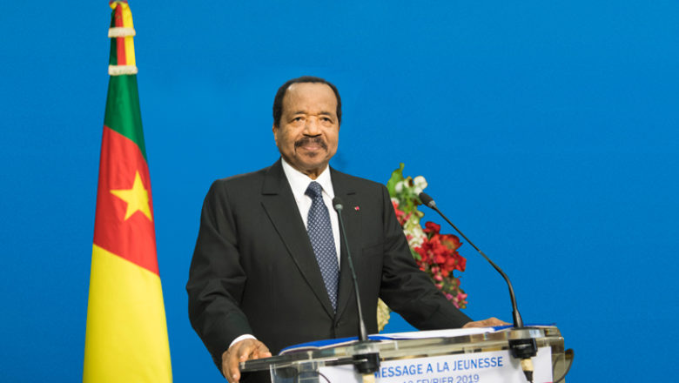

Slide 3
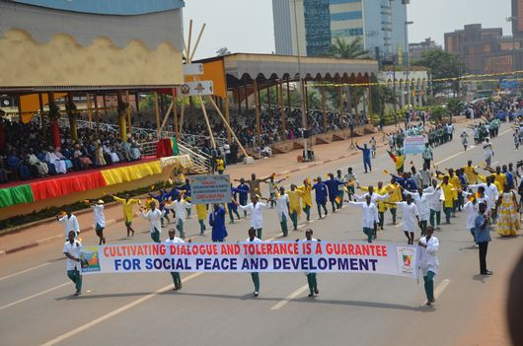
Youth Day in Cameroon is celebrated annually on February 11.
The celebration of the holiday reflects awareness and recognition of youth significance for the country.

Slide 6
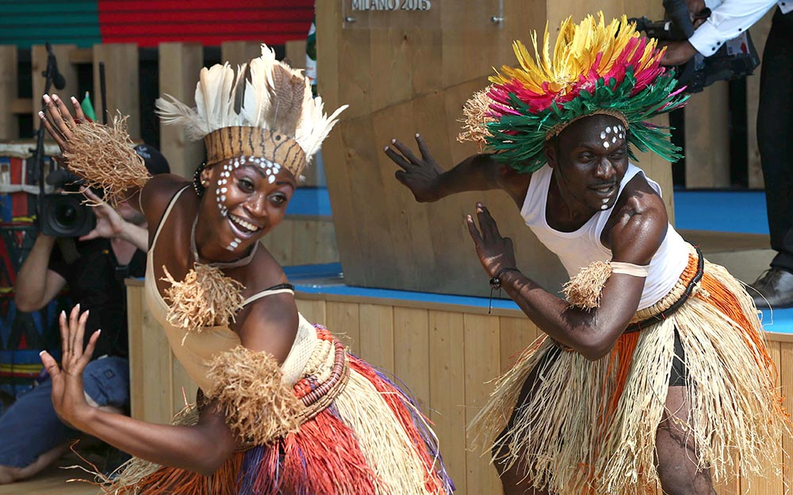

Slide 7
Thanks for attention!

