Slide 1
Международная сеть студентов по обмену в рамках программы Erasmus

Slide 2
ESN –крупнейшая студенческая ассоциация в Европе 16 октября 1989

Slide 4
Более 40 стран Более500 локальных секций 1000+ Вузов
Notes:
ESN consists of 520+ local associations in 40 countries working daily with international students. Each association has its own local board, with volunteers working in various positions. However, each branch has to have a president or local representative, who represents the section at the university/city and is the contact person on all levels – local, national and international.

Slide 5
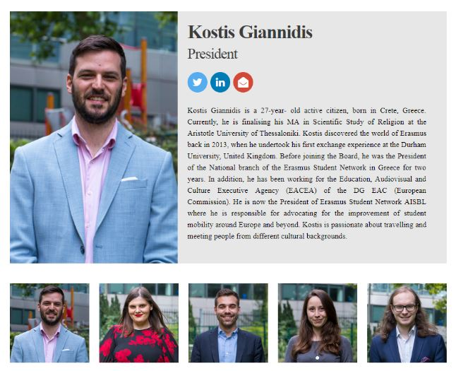
International Board 2019/2021

Slide 6
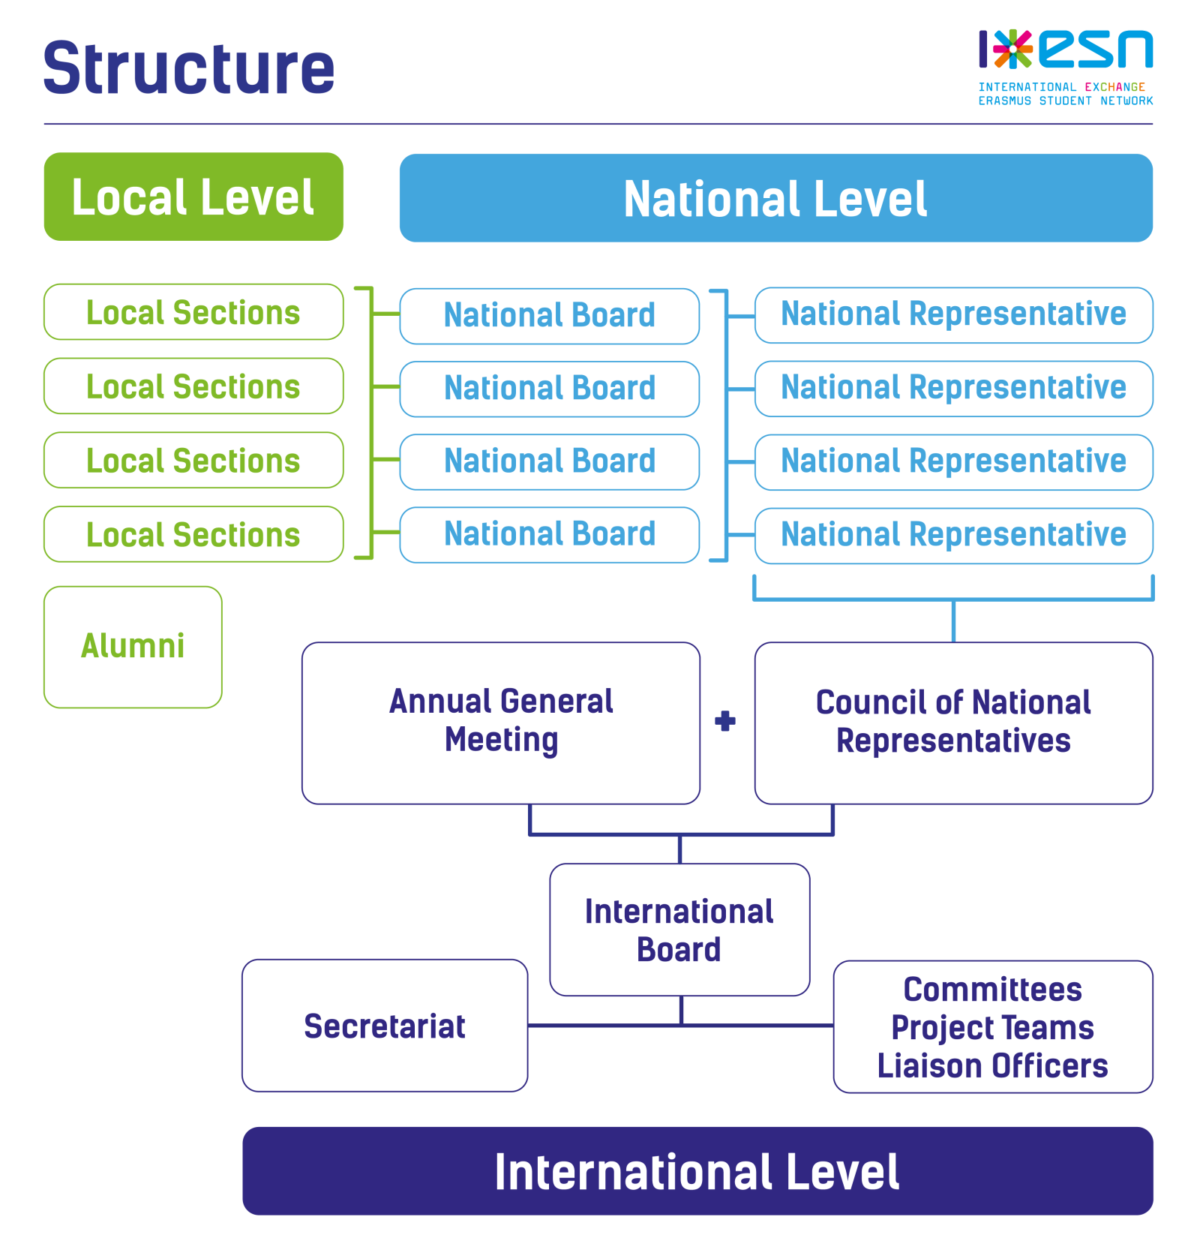

Slide 7
Какие плюсы несет в себе ESN?

Slide 8
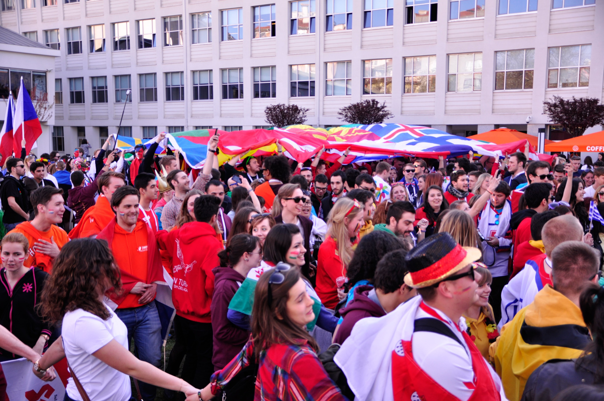
Установление новых личных и профессиональных контактов во всем мире
Notes:
By being present in 40 European countries and hundreds of universities and cities, you can expect a very diverse and multicultural society. Yet you'll see the similarities between seemingly different people as they are all united by the same cause - "students helping students".

Slide 9
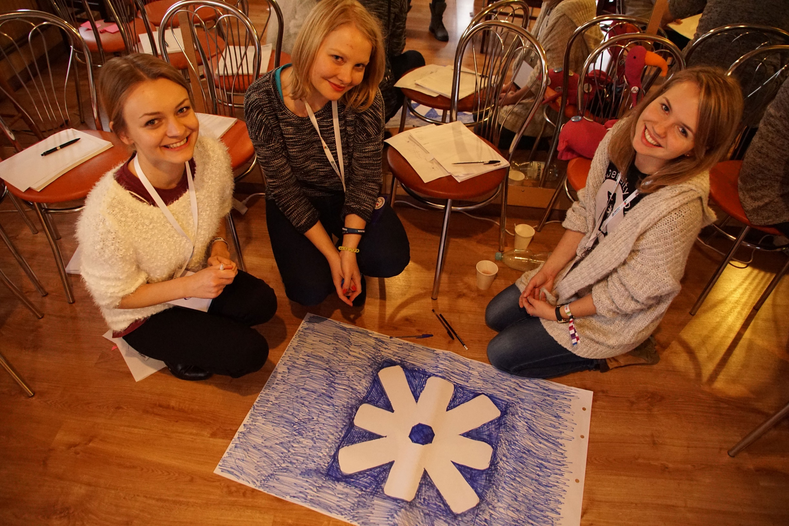
Практика иностранных языков
Notes:
International students add value to society through open-mindedness & intercultural awareness

Slide 10
Участие в международных студенческих конференциях и семинарах
Notes:
ESN is an academy where every volunteer is a student looking to find what he needs most. It can be friendships, contacts, skills or experiences, ESN can help you immensely and shape your future, personal growth, and development.

Slide 11
Наша деятельность

Slide 12
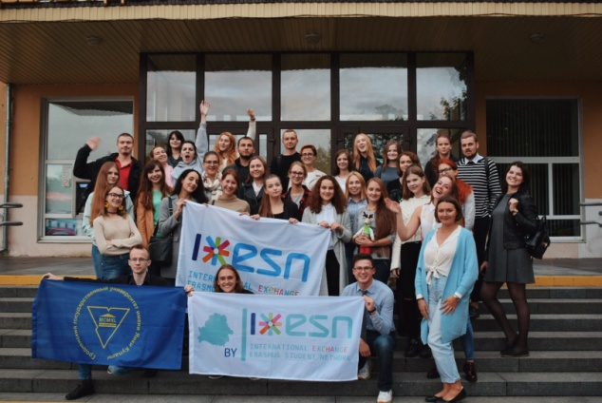
Мероприятия в университете

Slide 13
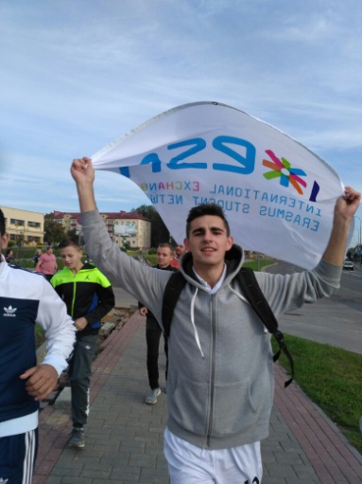
Спортивные мероприятия
Notes:
ErasmusIntern.org is an online platform that provides an integrated marketplace. It aims at bringing together traineeship providers and students seeking a training opportunity abroad.

Slide 14
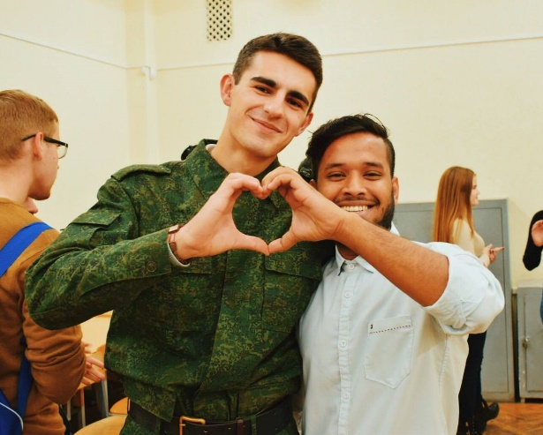
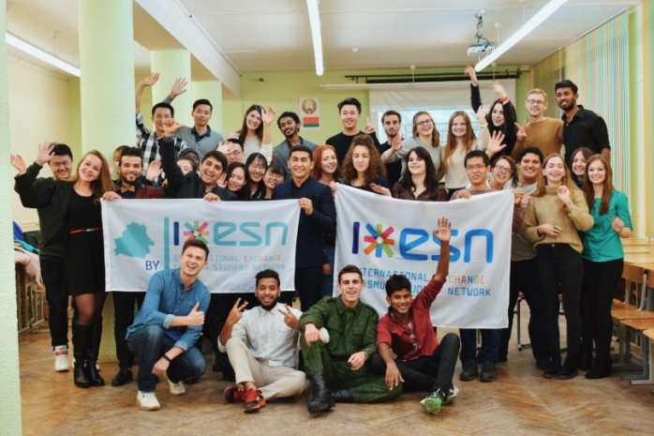
Вечера адаптации для иностранных студентов

Slide 15
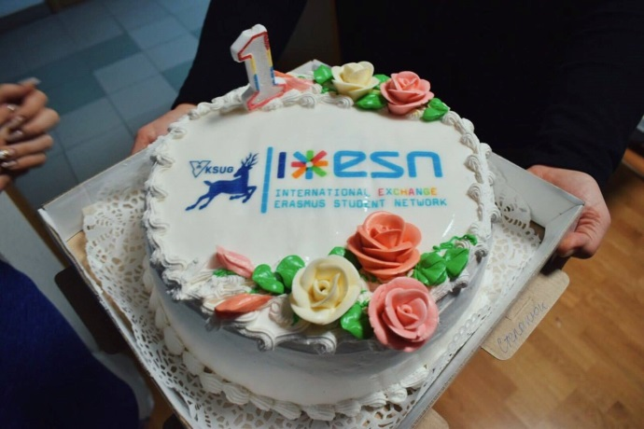
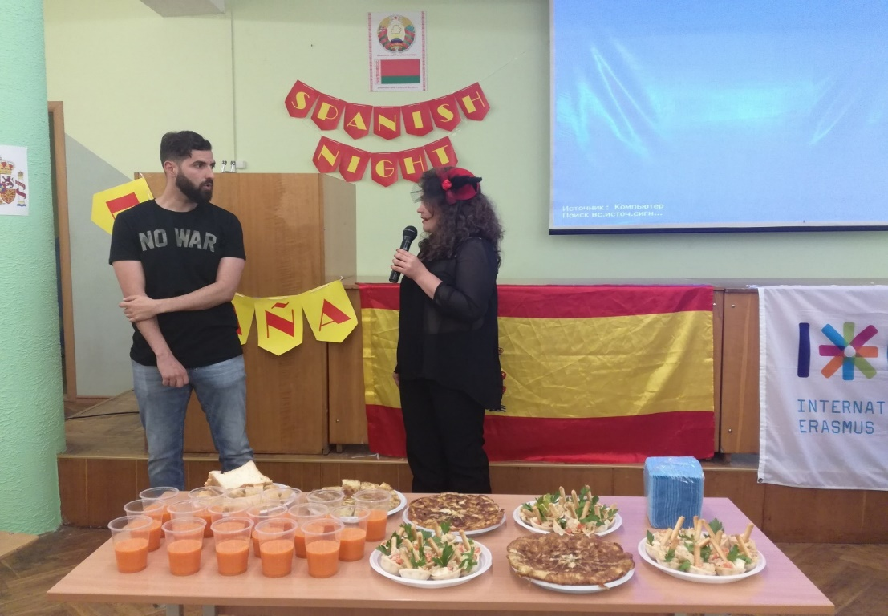
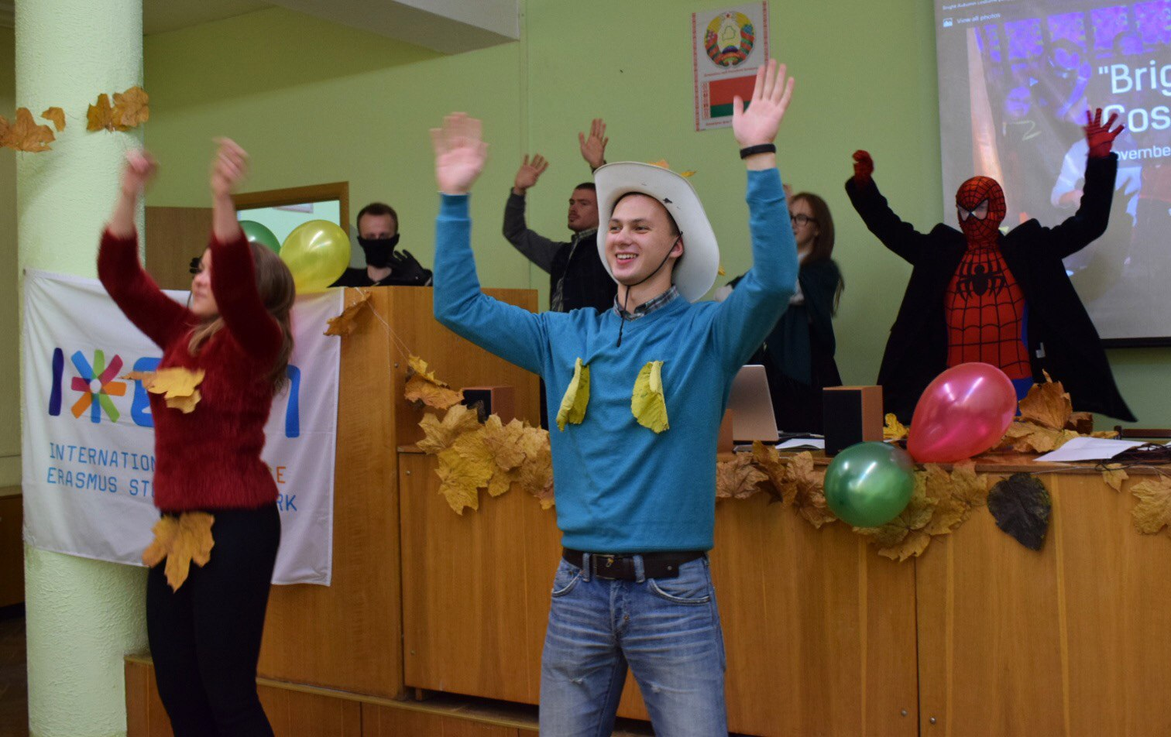
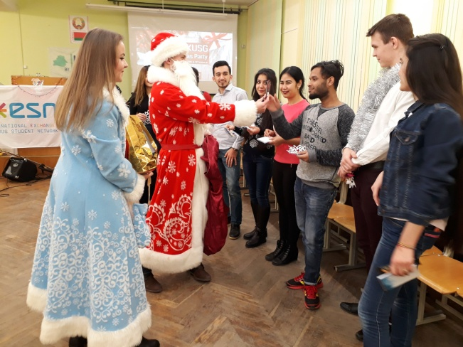

Slide 16
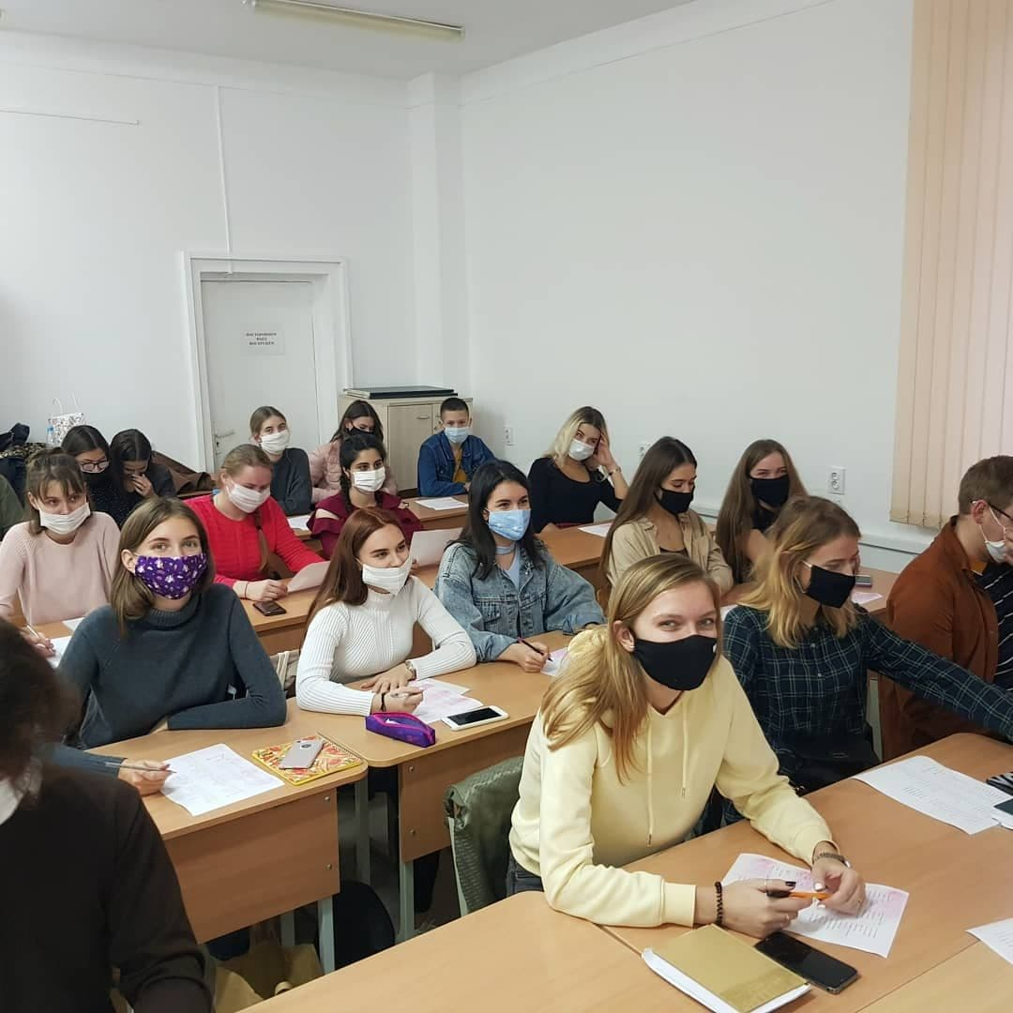
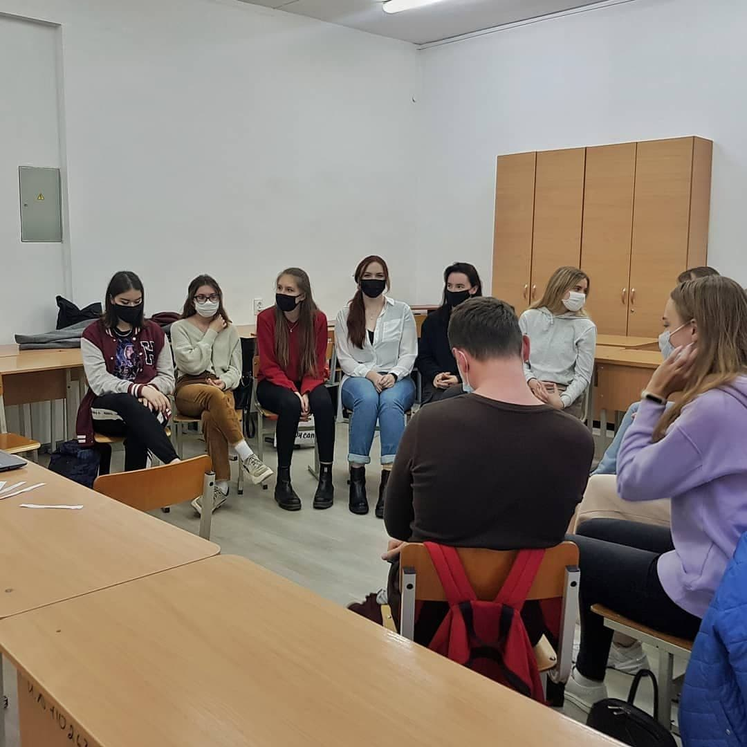
Языковые кафе

Slide 17
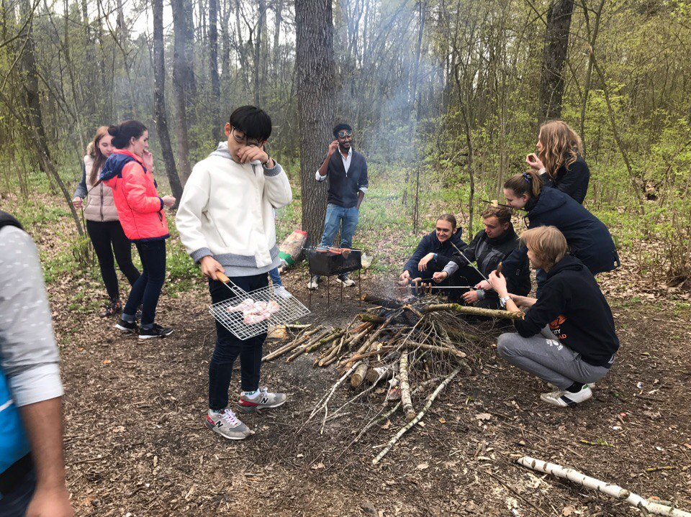
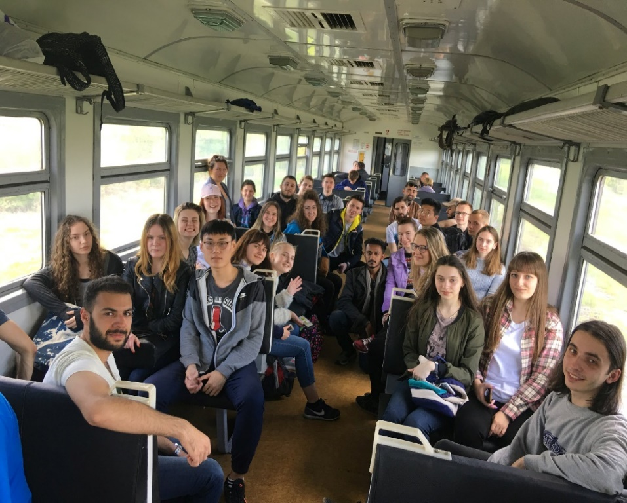
Выезды на природу

Slide 18
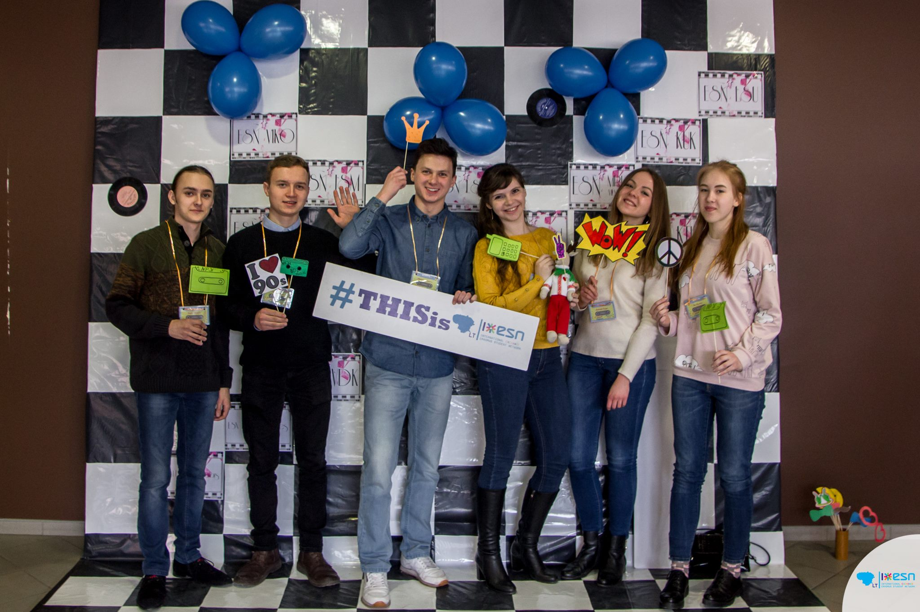
Международные встречи

Slide 20
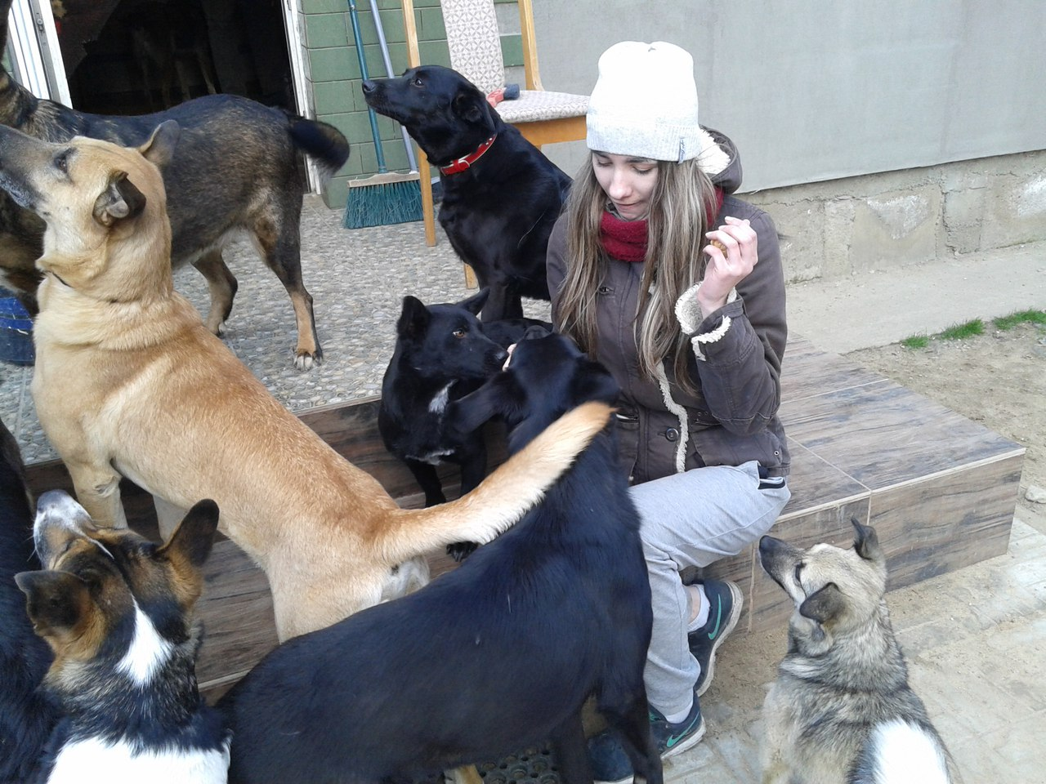
Делаем добро вместе!
Notes:
Another branch of our activity is engaging Erasmus students in changing the world for the better. SocialErasmus aims to involve young citizens into volunteering activities, which gives them a chance to make a long-lasting social change in local communities and leave their mark.

Slide 21
И многое-многое другое Хочешь узнать больше о нашей деятельности? Вступай в наши ряды!

Slide 22
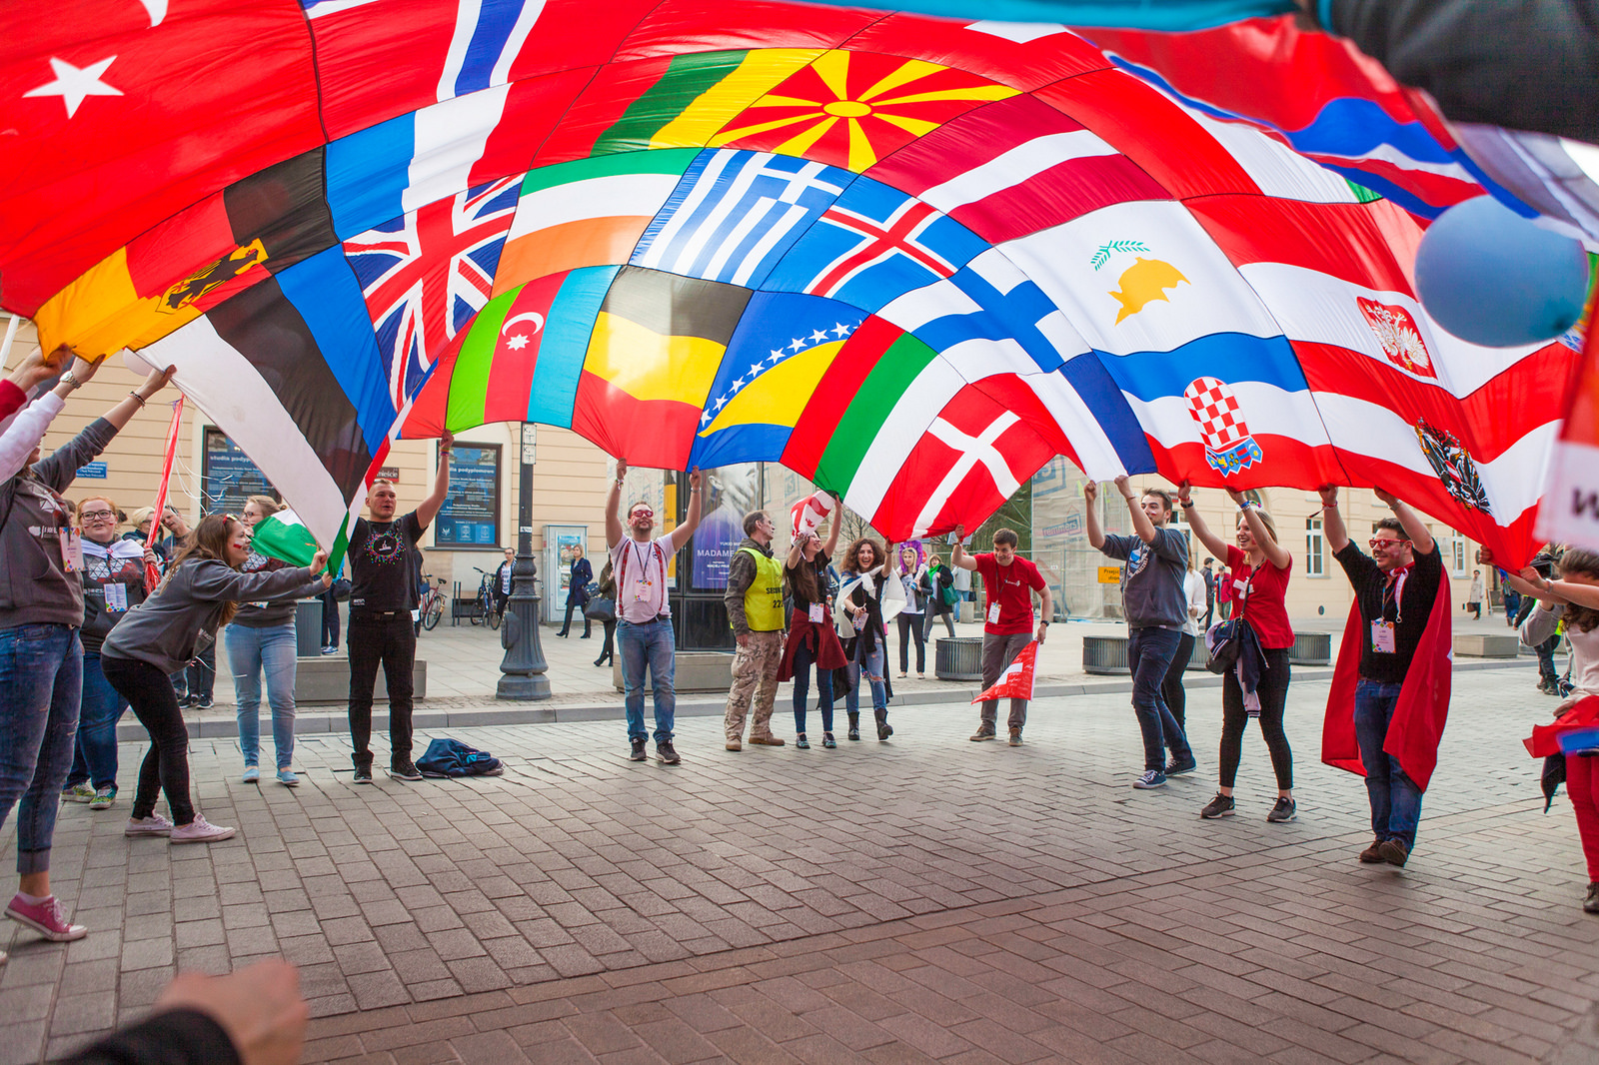
#THISisESN

Slide 23
Как вы можете нас найти:
ESN YKSUG, Belarus
esn_yksug_belarus

